Slide 1
Data Analysis of Adventure Works
By Ahmad Saraj

Slide 2
Project Objectives:
Identifying top-performing products and categories
Evaluating sales performance across different regions.
Understanding customer purchasing patterns.
Identifying factors influencing customer satisfaction and loyalty.

Slide 3
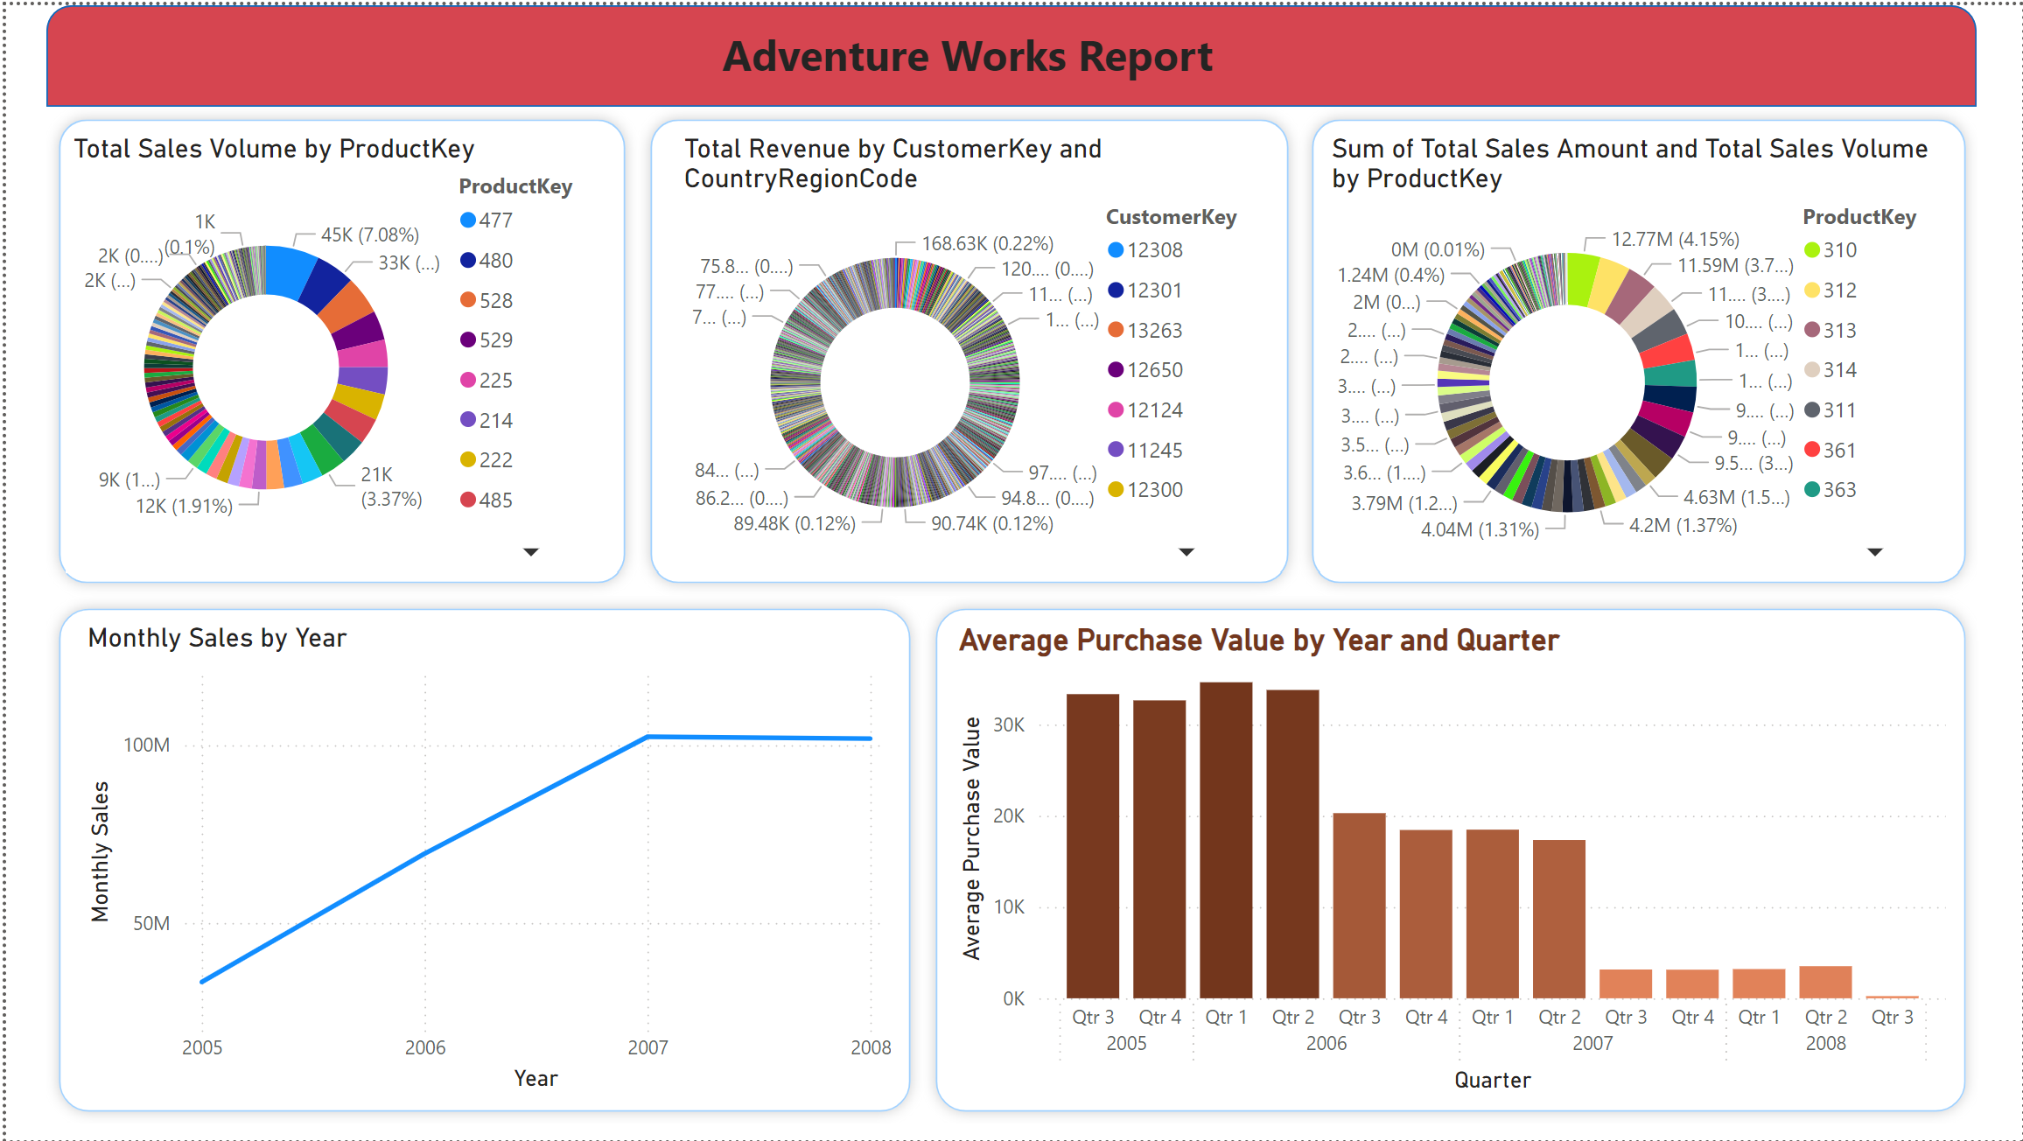
Identifying top-performing products and categories.

Slide 4
Insight of top-performing products and categories.
Top Products by Sales Volume:
The product with ProductKey 477 has the highest sales volume at 44,723 units.
Other top products include those with ProductKey 480, 528, 529, and 225, with sales volumes decreasing in that order.

Slide 5
Continued.
Top Customers by Revenue:
The customer with CustomerKey 11000 in Australia has generated the highest revenue at 52,448.86.
Other notable customers include those with CustomerKey 11003, 11006, 11008, and 11010, with revenues of 76,358.74, 64,037.63, 78,070.79, and 120,786.85, respectively.

Slide 6
Continued.
Top Products by Total Sales Amount:
The product with ProductKey 310 has the highest total sales amount at 12,774,423.90.
Other top products include those with ProductKey 312, 313, 311, and 361, with total sales amounts decreasing in that order.

Slide 7
Continued.
Sales Trends Over Years:
There is a clear upward trend in monthly sales from 2005 to 2007.
Sales significantly increased from 2005 to 2006, reaching over 100 million by 2006.
The trend continues into 2007 with a slight dip compared to 2006 but still maintaining high sales levels.

Slide 8
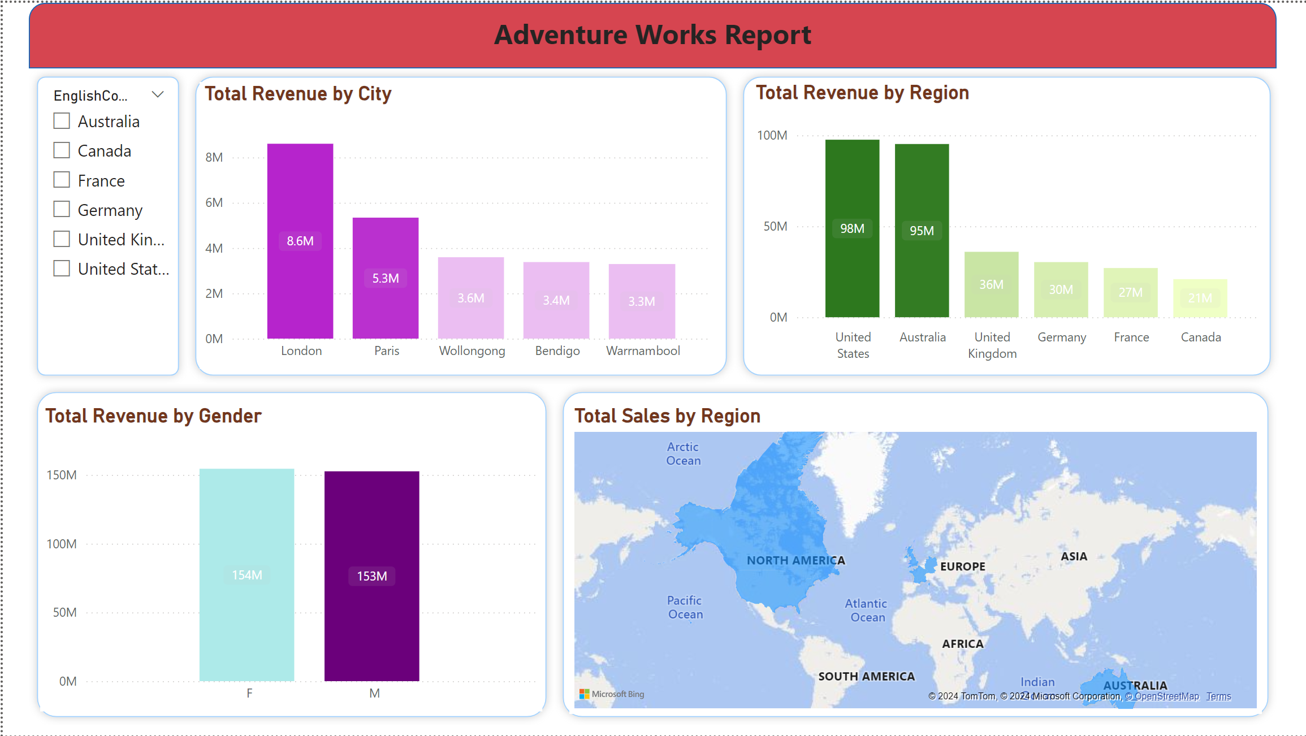
Evaluating sales performance across different regions.

Slide 9
Insights of Geographic Analysis
Top Cities by Revenue:
London leads in total revenue, significantly higher than other cities.
Paris follows as the second highest, with revenue close to that of London but still lower.
Other notable cities include Wollongong, Bendigo, and Warrnambool, with decreasing revenue in that order.

Slide 10
Total Revenue by Region
Top Regions by Revenue:
The United States and Australia are the top-performing regions, both generating similar and the highest total revenue.
The United Kingdom and Germany follow, generating moderate revenue compared to the top two.
France and Canada have the lowest revenue among the regions displayed.

Slide 11
Total Revenue by Gender
Gender Analysis:
Revenue generation is almost evenly split between male and female customers.
Both genders contribute significantly to total revenue, with no noticeable difference in revenue contribution.

Slide 12
Total Sales by Region (Map Visualization)
Geographic Distribution of Sales:
North America (United States) and Australia show the highest sales activity, as indicated by the darker shades on the map.
Europe (notably the United Kingdom and Germany) also shows notable sales activity but less compared to North America and Australia.
Other regions such as Canada and France show lower sales activity.

Slide 13
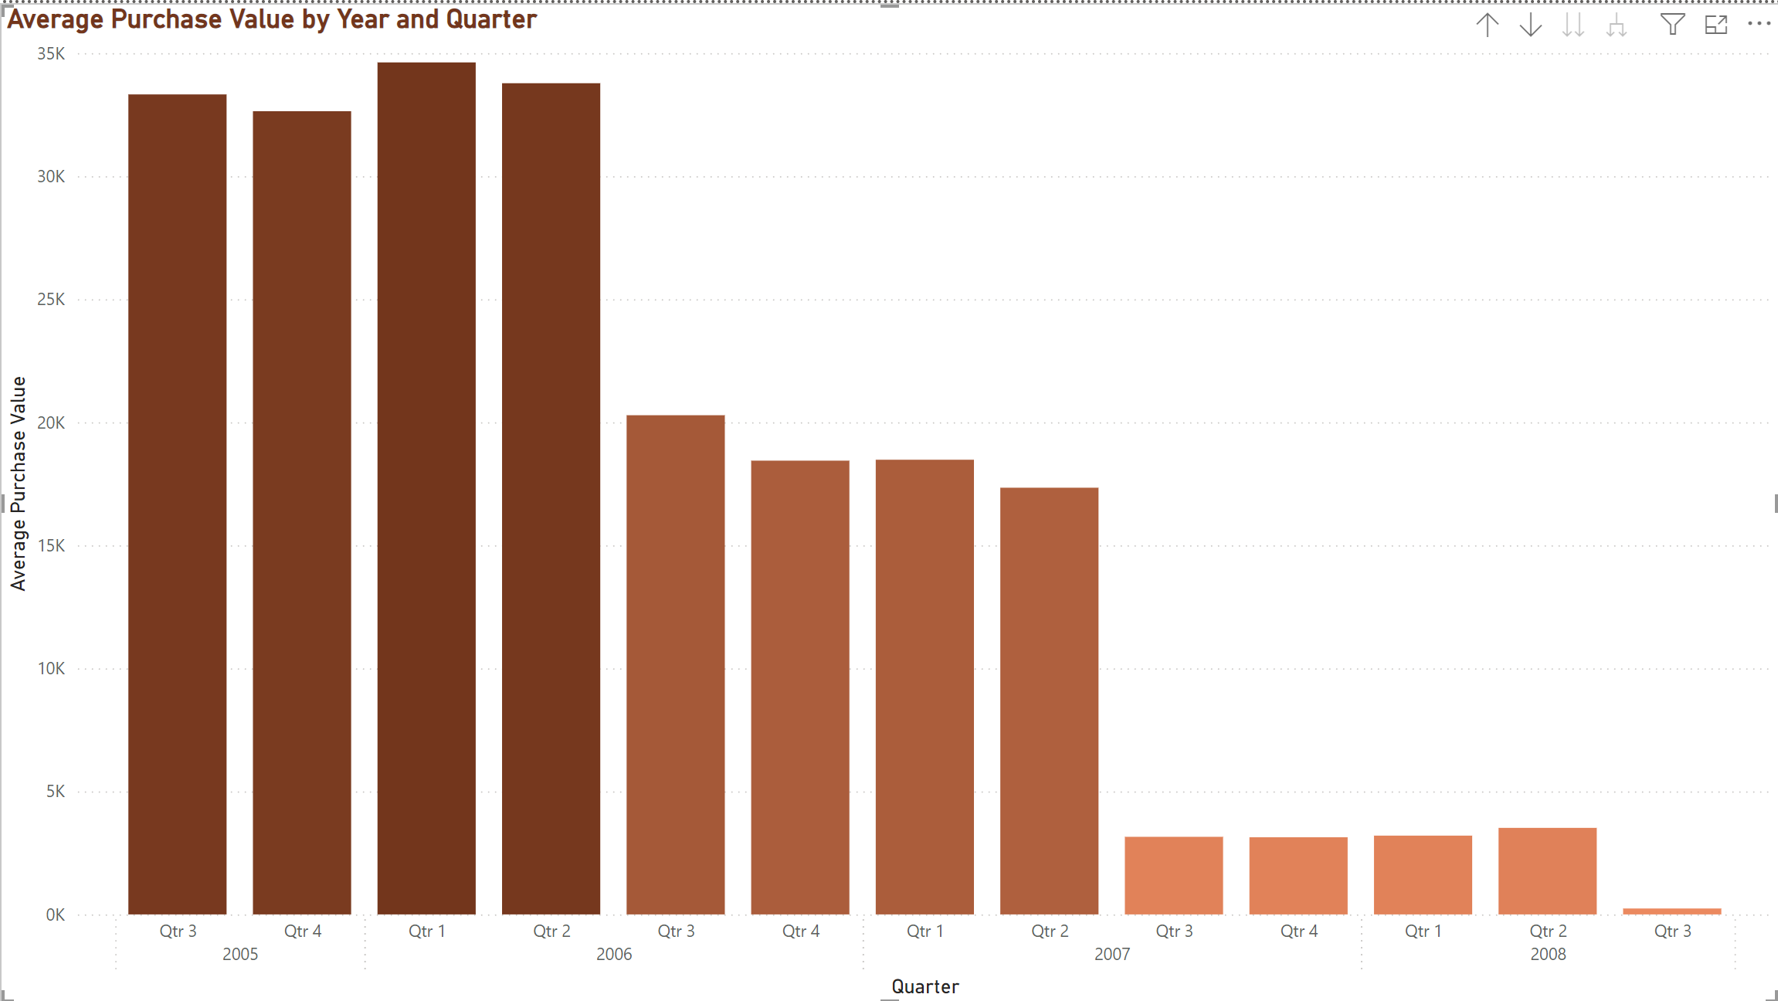
Understanding customer purchasing patterns.

Slide 14
Inights of customer purchasing patterns.
Trends Over Time:
2005:
The average purchase value was highest in Q3 and Q4, both exceeding 30K.
Q1 of 2006 continued this trend with an average purchase value just over 30K.

Slide 15
Continued.
2006:
Q2 saw a slight drop in average purchase value, still remaining above 20K.
Q3 of 2006 experienced a recovery to above 30K.
Q4 saw a decline in average purchase value to just below 25K.

Slide 16
Continued.
2007:
The average purchase value remained consistent at just above 10K for Q1, Q2, and Q3.
There was a slight decrease in Q4, staying around 10K.

Slide 17
Continued.
2008:
The first two quarters showed stable average purchase values around 10K.
A significant drop occurred in Q3 of 2008, with the average purchase value falling to nearly 0K.

